Slide 1
HOW DO THE SEMINARS OF BASIC BUDGET AWARENESS AFFECT ON GENERATION Z? THE CASE OF UNDERGRADUATES
Assoc. Prof. Dr. Gonca GÜNGÖR GÖKSU
Sakarya University
Faculty of Political Science
Department of Public Finance

Slide 2
This study was supported by the Scientific and Technological Research Council of Turkey (TUBITAK) under the project number 123K798. We would like to thank TUBITAK for its support to the project.

Slide 3
Our aim was to assess and improve the budget awareness of generation Z undergraduates, who not only constitute a significant portion of the voting population in most countries but are also future decision-makers.
Its primary motivation is to identify and improve the level of budget awareness of Generation Z, who are future decision-makers and constitute the majority of the voting population in Turkiye.

Slide 4
To achieve our aim, we conducted the "Basic Budget Awareness" seminars at four Turkish state universities: Çanakkale Onsekiz Mart University (ÇOMU), Eskişehir Osmangazi University (ESOGU), Mersin University (MEU), and Sakarya University (SAU), between December 2023 and May 2024.
We conducted the pre-and post-test before and after seminars and we detected the data were normally distributed.
Thus, we applied a Paired T-Test, one of most widely used the statistical technique to compare two samples, using the SPSS software program to analyse the data.

Slide 5
Budget Awareness means that:
Citizens are interested in the state budget issues within the constitution and other laws,
They have sufficient knowledge about public revenues and the public services for which these revenues are spent,
and also they closely follow budget-related improvements.

Slide 6
Prior to the seminars, we performed a pre-test consisting of 13 items to measure the participants' initial budget awareness levels.
10-15 days later after the seminars, we sent a post-test through Google forms and 407 participants responded the second test.
At least 384 participants was statistically accepted sufficient to represent the main mass for the sample universities. (In our research, the alpha level was 0.05, known as the 95% confidence limit, and the sampling margin of error was accepted as ±5)
Therefore, this approach allowed us to compare the effects of the seminars on the budget awareness of undergraduates.

Slide 7
Our Hypothesis
H0: There is not a notable difference between the pre-test and post-test measures, highlighting the effectiveness of the “Basic Budget Seminars” in enhancing budget awareness of Generation Z undergraduates.
H1: There is a notable difference between the pre-test and post-test measures, adressing the effectiveness of the “Basic Budget Seminars” in enhancing budget awareness of Generation Z undergraduates.

Slide 8
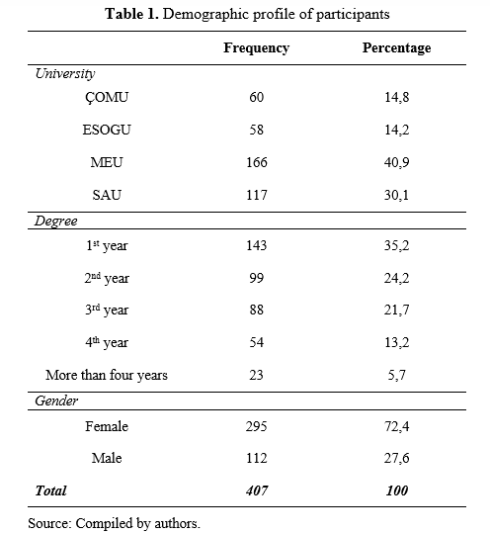

Slide 9
The high reliability scores - Cronbach’s Alpha: 0.91 for pre-test and 0.95 for post-test- and the consistent statistical significance across all measured pairs reinforce the robustness of the findings.

Slide 10
Table 2. Frequencies and value variations for each item
Items | N | Mean (Pre-test) | Mean (Post-test) | Increase percent
1. I am knowledgeable about the Citizen's Budget Guide and the Citizen's Final Account Report. | 407 | 2,151 | 3,464 | 61,04
2. I am sufficiently informed about the state budget. | 407 | 2,558 | 3,169 | 23,89
3. I am interest in matters related to the state budget. | 407 | 2,421 | 3,115 | 28,67
4. I am knowledgeable about the figures of public income within the state budget. | 407 | 2,381 | 3,034 | 27,43
5. I am knowledgeable about the figures of public spending within the state budget. | 407 | 2,727 | 3,130 | 14,78
6. I am knowledgeable about how public funds are designated for various spending categories within the state budget. | 407 | 2,494 | 3,071 | 33,72
7. I am knowledgeable about the methods and procedures used in creating budgets and the financial transactions that occur as part of budget management. | 407 | 2,651 | 3,545 | 56,91

Slide 11
Items | N | Mean (Pre-test) | Mean (Post-test) | Increase percent
8. I am knowledgeable about a government-endorsed online platform that disseminates details and statistics related to the state budget. | 407 | 1,968 | 3,088 | 46,27
9. I am knowledgeable about the Public Financial Management and Control Law No. 5018. | 407 | 3,084 | 3,648 | 18,29
10. I am knowledgeable about the link between taxes and public services. | 407 | 2,393 | 3,648 | 52,44
11. I am knowledgeable about the constitutional power of the purse. | 407 | 3,465 | 3,936 | 13,60
12. I am knowledgeable about how public funds are distributed among various public services. | 407 | 2,663 | 3,117 | 17,05
13. I consider to have an awareness of the state budget | 407 | 2,558 | 3,508 | 37,14

Slide 12
Table 3. Budget awareness scores by pre-test and post-test
 | N | Pre-test | Post-test | Increase Percent | Sig. (2-tailed)
Budget Awareness Scores | 407 | 2,60 | 3,39 | 30% | ,000
This finding suggests that the “Basic Budget Awareness” seminars effectively improved the participants' understanding and awareness of public budgeting.
According to the paired t-test findings, the statistical significance of this increase, with a p-value of 0.000 that confirms that the observed improvement in budget awareness scores is highly significant and not attributable to random variation. The Sig. (2-tailed) < 0.05 and H1 is accepted.

Slide 13
Such a low p-value (of 0.000) indicates a strong correlation between the seminars.
The findings confirm the effectiveness of the educational intervention in enhancing participants' understanding of key budget-related concepts, such as public revenues, expenditures, and the constitutional power of the purse.

Slide 14
The study results underscored the value of targeted educational programs in improving financial literacy and public engagement with state budget processes, particularly among young adults.
In conclusion, the "Basic Budget Awareness" seminars proved to be a highly effective tool for enhancing budget awareness among Generation Z undergraduates.

Slide 15
THANKS FOR YOUR LISTENING. ANY QUESTIONS?

